Slide 1
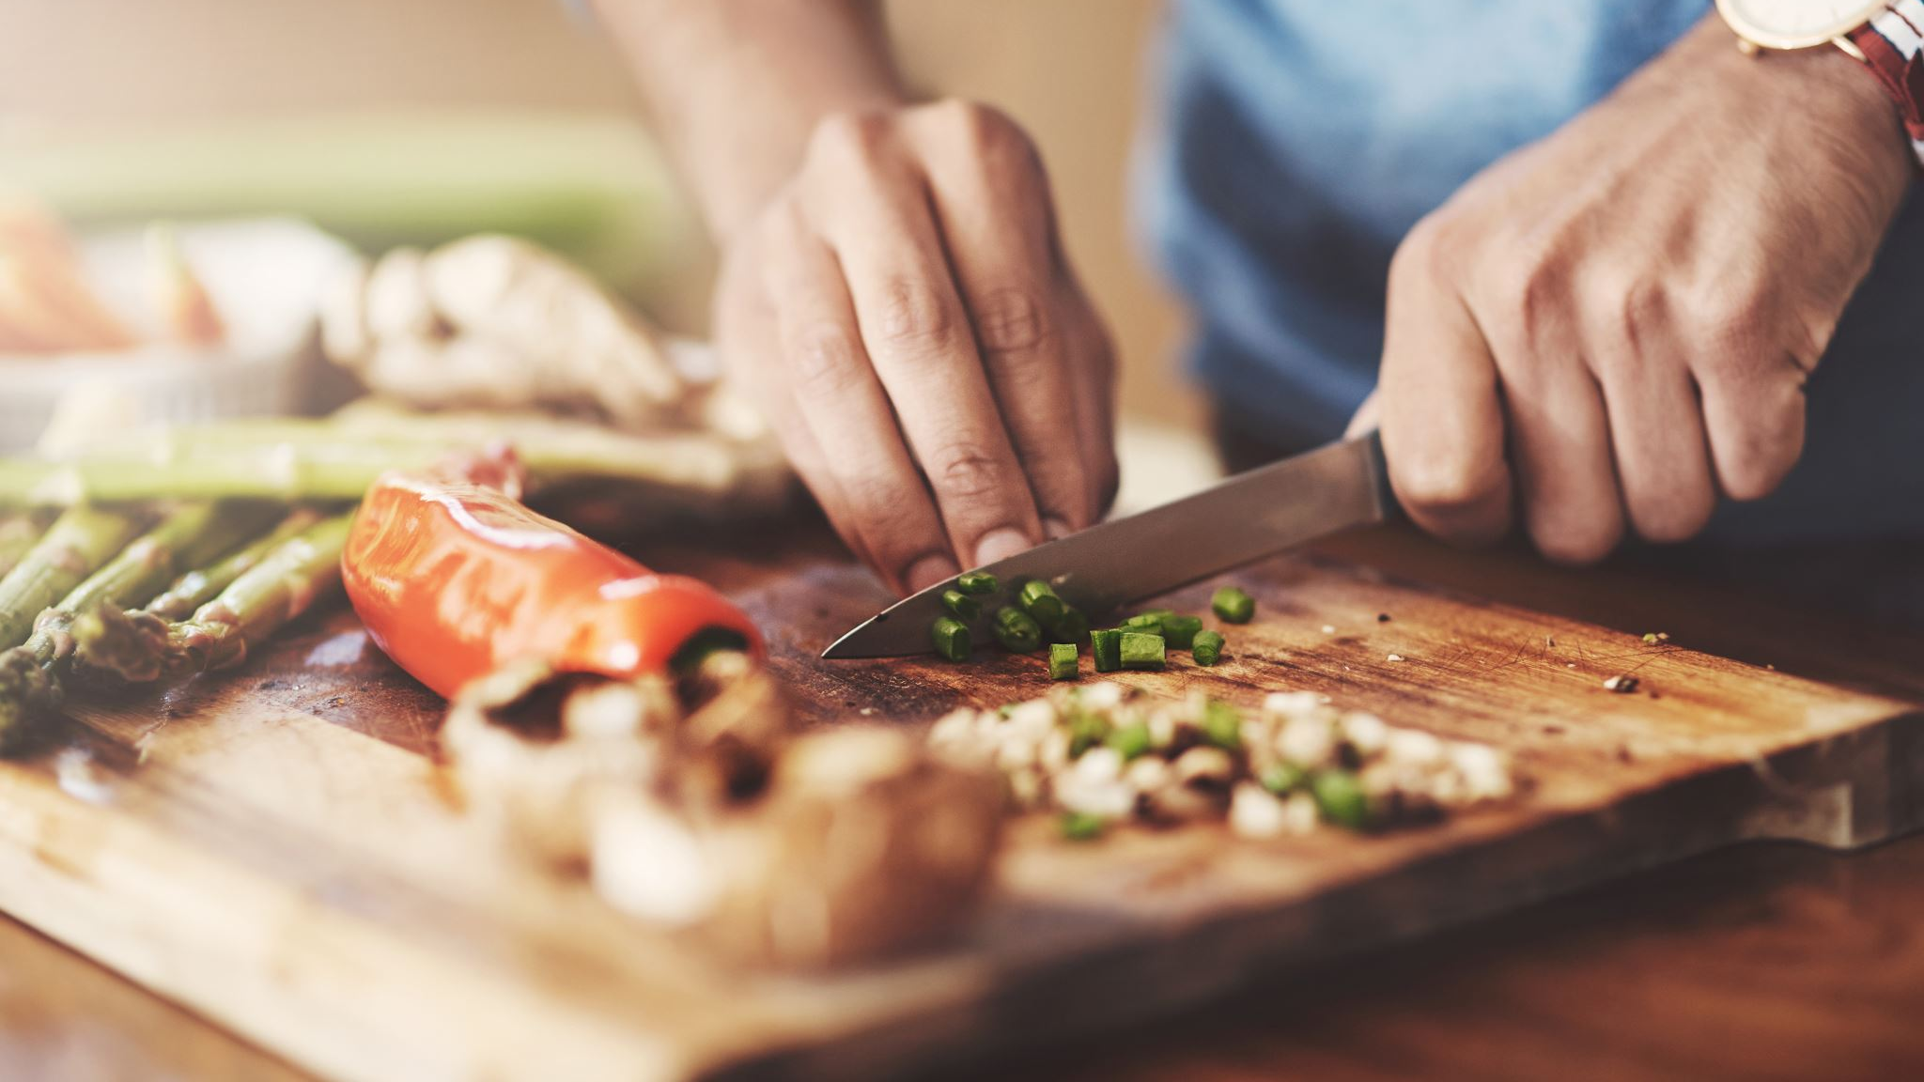
Cooking App
By: Ashwath PadmeGowda, Jeff Santucci, Lisa Whitley, & Steven Woods

Slide 2
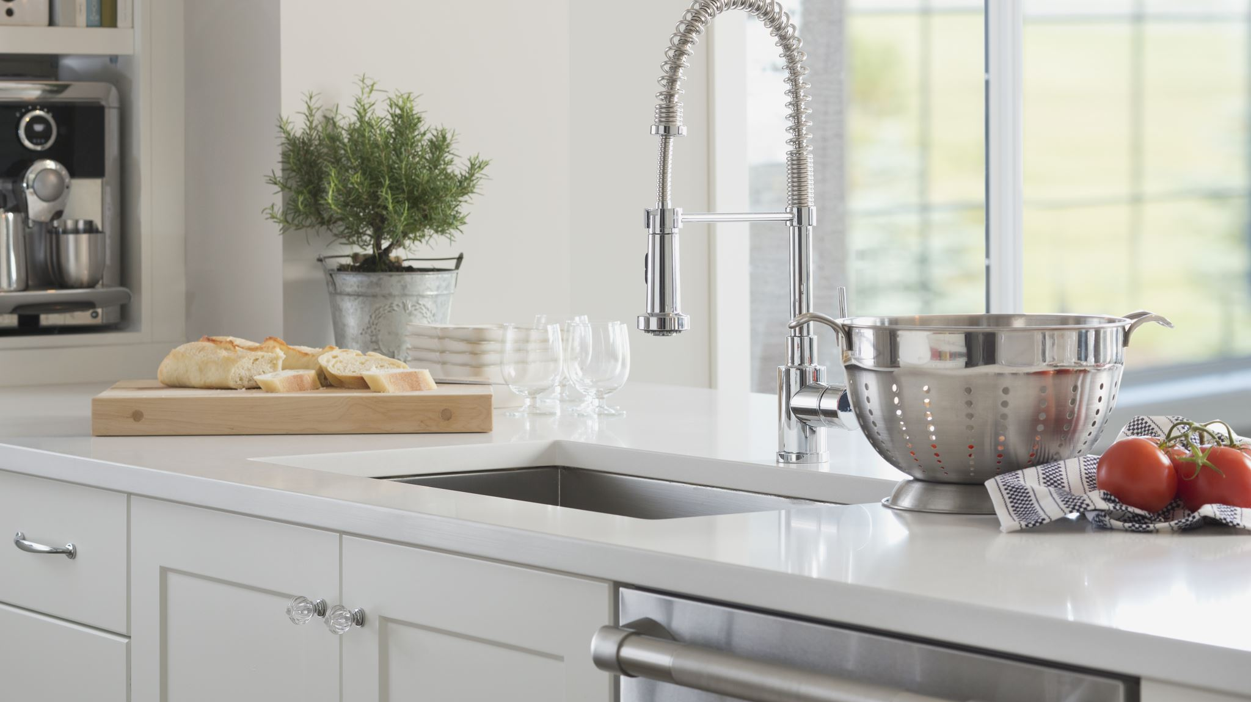
Want to cook something new? Have random ingredients left in your fridge?
Come check out our app! We can help you create a new dish with what you have in your fridge!

Slide 3
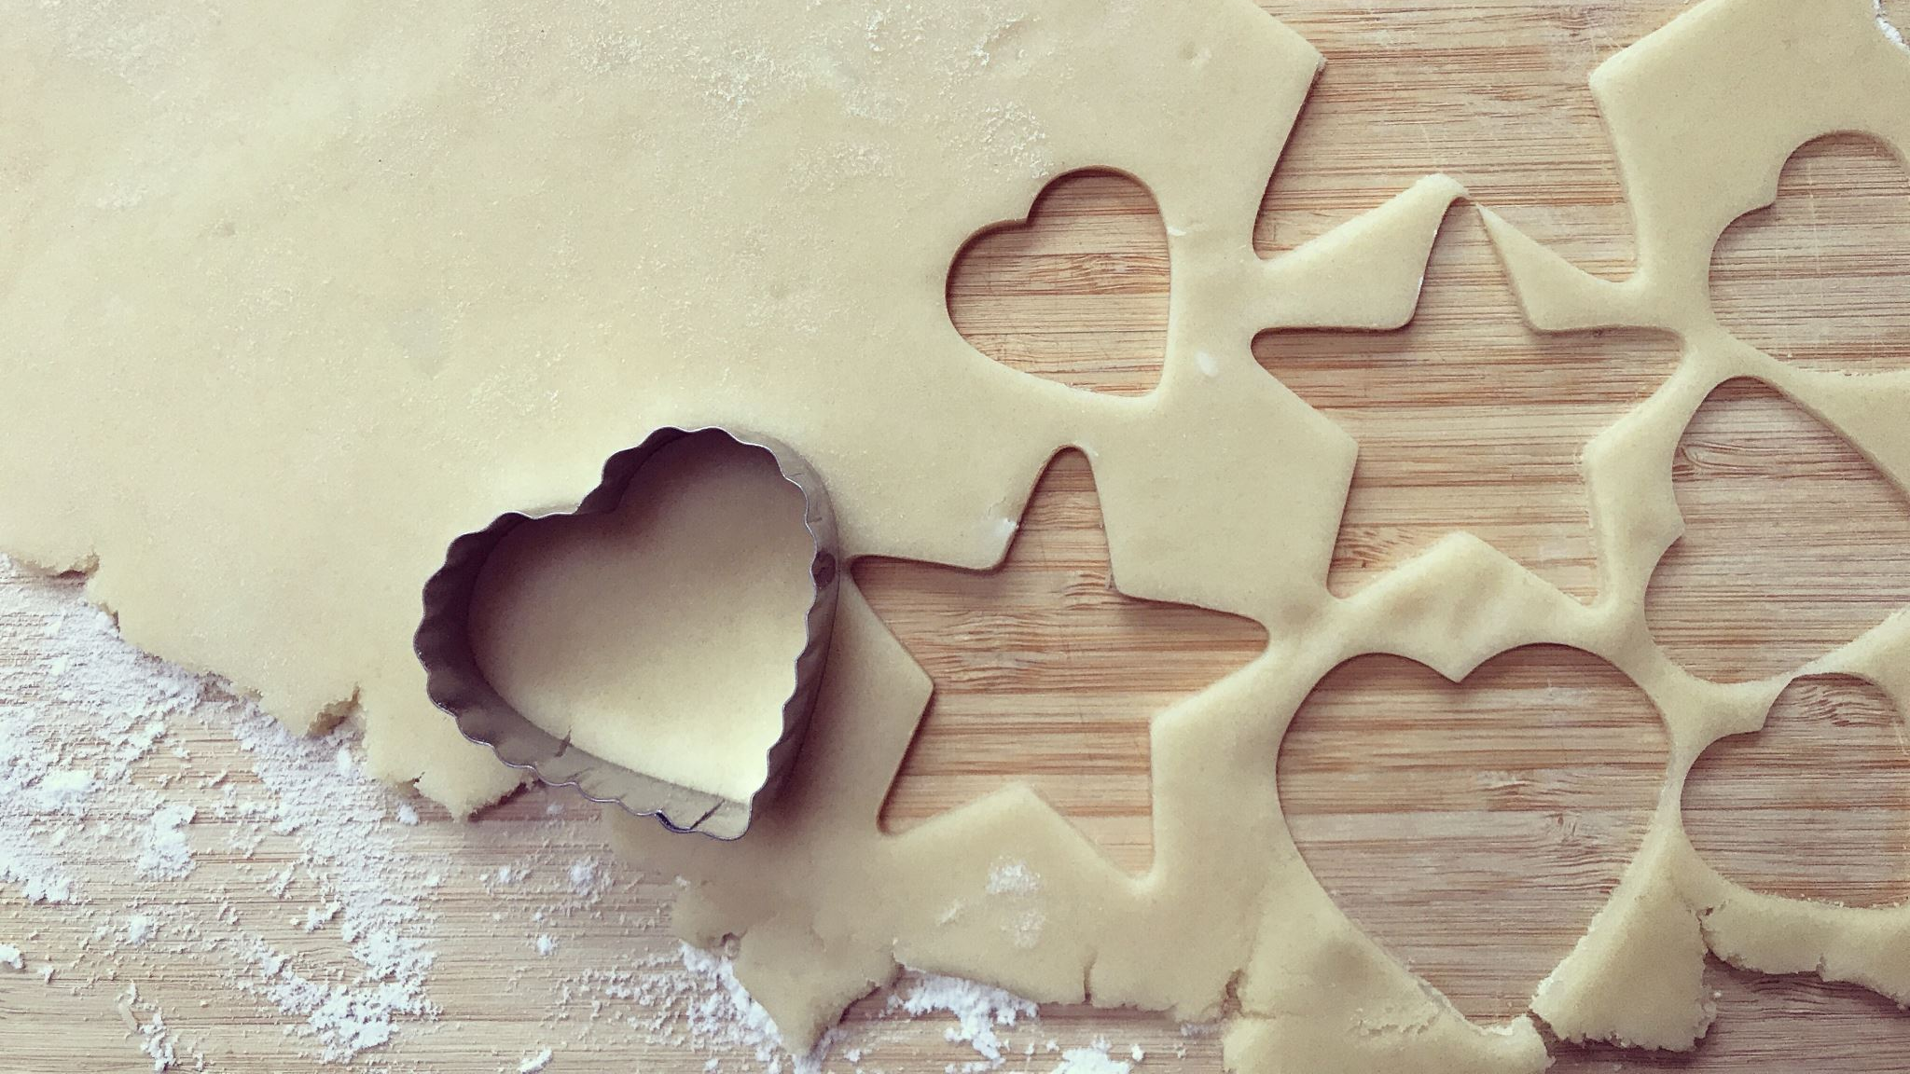
Demo time!
Let’s take a look under the hood!!

Slide 4
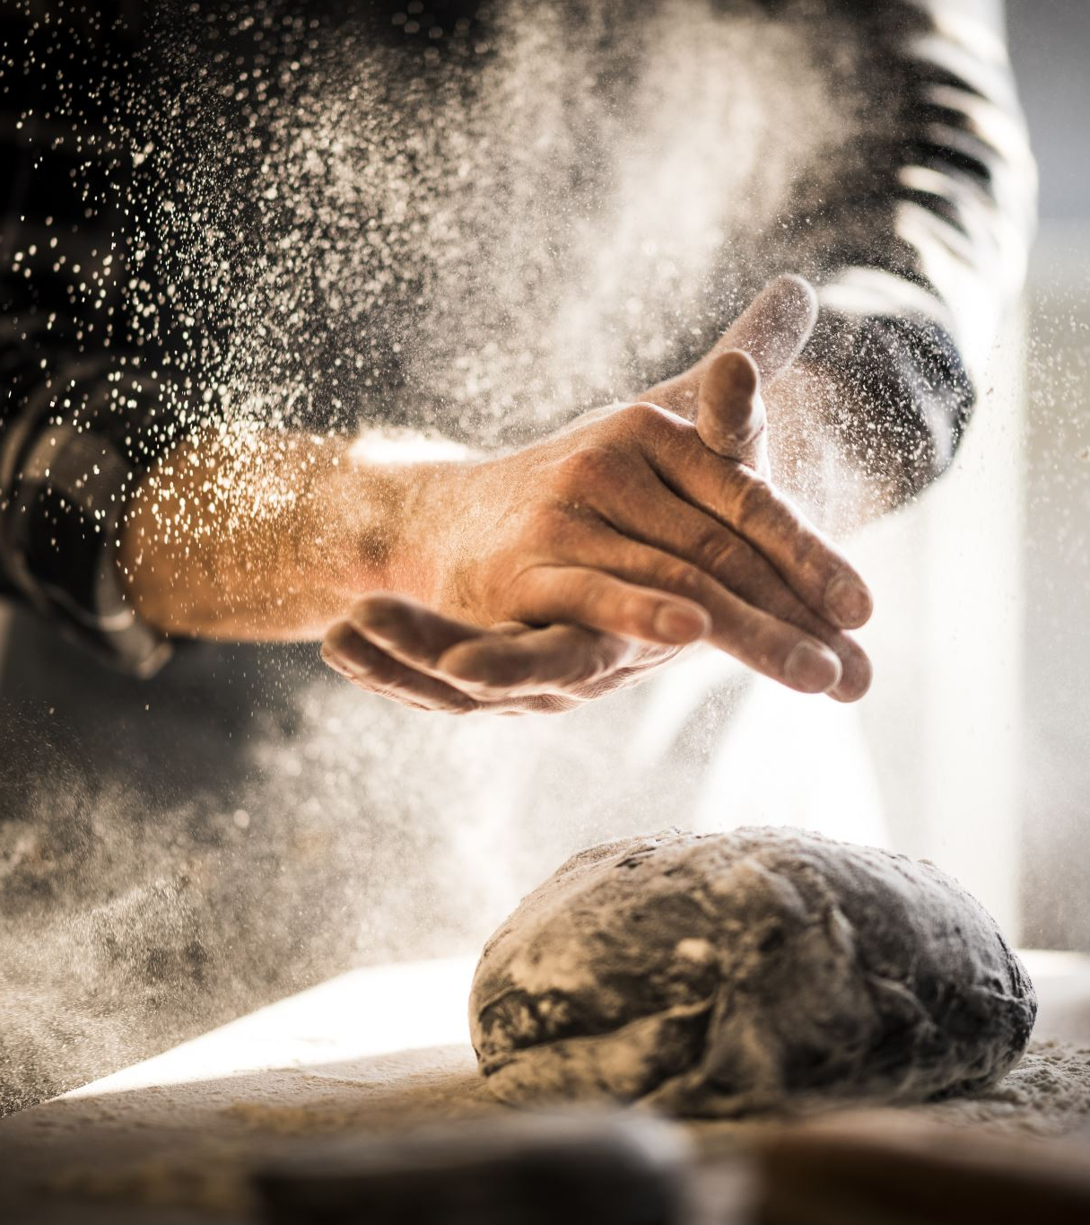
Process
Technologies used:
Challenges:
Successes:
Future developments:

Slide 5
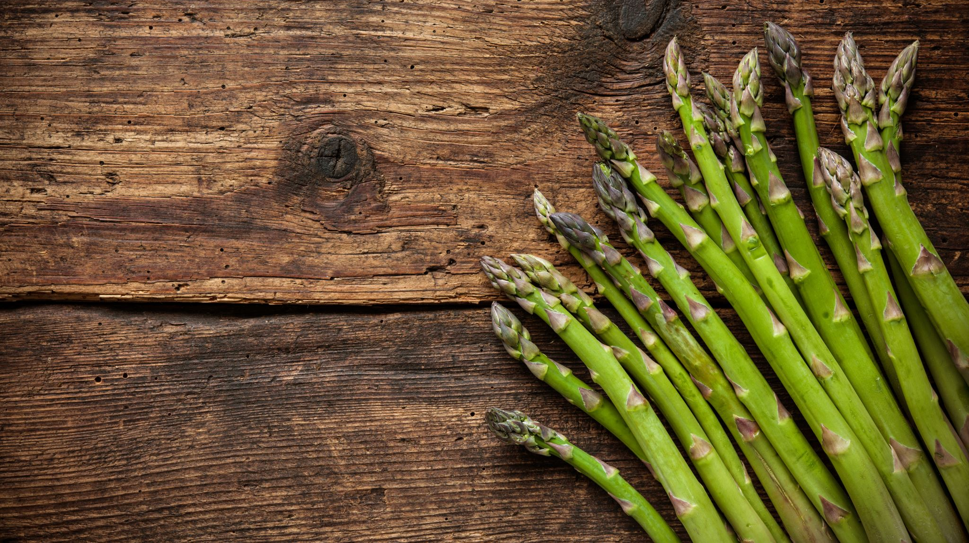
Cooking Links To Project
https://github.com/WhitleyLisa/CookingApp

Slide 6
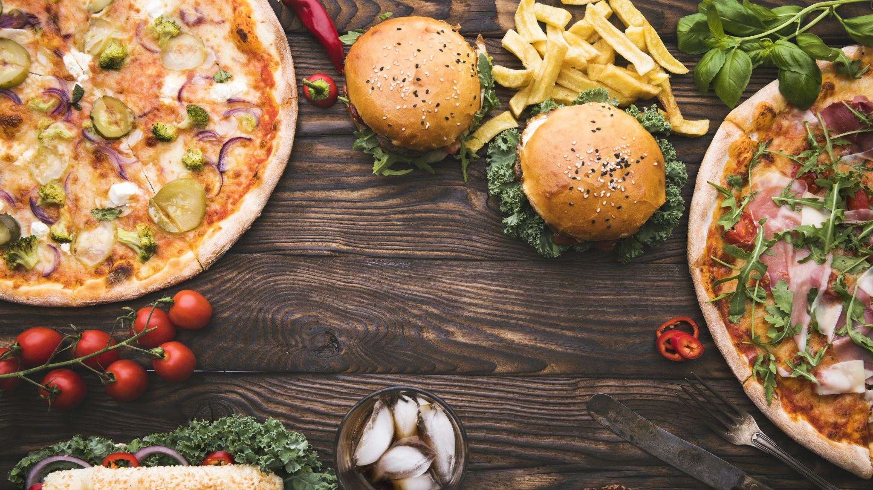
Any Questions?!
We have answers for that!

